Slide 1
Introduction to HCAHPS
2023
Finding the pulse of your business

Slide 2
Objectives
Overview of HCAHPS
Sampling
“Top Box” Methodology
Life Cycle of a Survey
HCAHPS National Performance
HCAHPS Star Ratings
JLM Power BI Survey Reports

Slide 3
What is CAHPS?
Consumer Assessment of Healthcare Providers and Systems
Developed by AHRQ to provide customers a standardized survey of 27 questions evaluating their patient experience.
Results are transparent
Can be used for comparisons
Survey result help leadership to make better informed decisions.

Slide 4
HCAHPS Composite Measures
Composite Questions | Responses
Communication with Nurses Communication with Doctors Staff Responsiveness Pain Management Communication about Medicines Cleanliness and Quietness Discharge Instructions | Always Usually Sometimes Never
Overall Rating | Rating from “0” (Poor) to “9/10” (Excellent)
Would you recommend | Definitely “Yes” Probably “Yes” No
Care Transition (Reported Oct14) | Strongly Agree Agree Disagree Strongly Disagree
Bold=“Top Box”
* www.hcahpsonline.org

Slide 5
Who Is Surveyed Under CMS Guidelines?
Eligible patients are:
Patients discharged from short-term, acute care hospitals
Age 18 years or over.
Non-Psychiatric DRG/principal diagnosis at discharge.
At least one overnight stay.
Excluded Patients
“No publicity” patients
Patients admitted to hospital within Police custody
Discharges with a foreign home address
Discharges to Hospice/Nursing Home/SNF

Slide 6
HCAHPS Methodology
Phone methodology
Standardized script
Complex procedures
Begin calls at least 48 hours after discharge.
1st call made before 42 days after discharge.
5 attempts for all randomly selected patients must be at:
Different times of the day.
Different days of the week.
Different weeks
Must be over the span of 8 days.
Last call completed 42 days after 1st attempt.
Survey callers can not leave voicemail.

Slide 7
HCAHPS Mix and Mode Adjustments
Before scores are published to the public, HCAHPS scores are also mix and mode adjusted.
Patient Mix (Determined by patient populations, service line, demographics, etc..)
Mode Adjusted by Survey Type (Phone only, mixed, IVR)

Slide 8
HCAHPS Mix and Mode Adjustments (Phone Survey)
HCAHPS Composite | Mode Adjustment (Phone)
Nursing Communication | -5.1%
Doctor Communication | -2.3%
Responsiveness | -2.4%
Care Transition | -0.6%
Communication Medications | -6.3%
Discharge Information | -1.4%
Cleanliness | -0.9%
Quietness | -6.6%
Would Recommend | -3.0%
Overall Rating | -0.5%

Slide 9
Takeaway
Always compare your HCAHPS scores to the rest of the country
(79% may actually be top in the nation!)

Slide 10
Life Cycle of a Survey (HCAHPS)
Patient discharged from hospital
By end of third week, first week of discharges surveys begin*
Hospital assigns DRG and upload to FTP site
JLM receives file, scrubs data, survey (5 Calls)
(Must span 8 days)
COMPLETED

Slide 11
Life Cycle of a Survey (Discharge Outcome)
Pt D/C
Survey/Cmp

Slide 12
HCAHPS Star Ratings

Slide 13
Star Ratings
As part of the initiative to add five-star quality ratings to its Compare Web sites, the Centers for Medicare & Medicaid. Services (CMS) publish HCAHPS Star Ratings on its Hospital Compare Web site.
Easier for consumers to spotlight excellence in healthcare quality
Will be based on the same HCAHPS questions
Star ratings for each composite plus new “HCAHPS Summary Star Rating”

Slide 14
Scoring Methodology
Star ratings will NOT follow “Top Box” methodology
CMS employs all survey responses in the construction of the HCAHPS Star Ratings
Each response assigned a score
Scores are calculated, assigned an average and rounded up or down
Final scores will be patient mix and mode adjusted

Slide 15
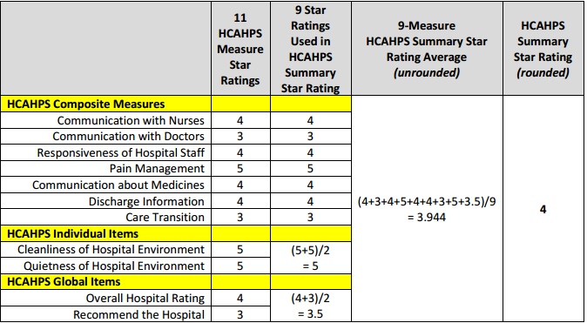
Scoring Methodology Example

Slide 16
Power BI Survey Reporting Tool

Slide 17
Solutions Survey Reporting Tool*
Provides snapshot regarding the patient’s experience for:
HCAHPS, Home Health, Emergency Department or Outpatient Services
Available in real-time upon completion of surveys
Able to trend monthly, quarterly or annually
Query – Analyze multiple levels of data on demand
* JLM Proprietary Database

Slide 18
Getting the most out of Solutions reporting
Run high level reports to identify trends or areas for improvement.
Utilize Top Box and Monthly reports to drill down further to discover areas of concern.
Share information with staff and develop action plans based on findings.
Compare your data to the national data.

Slide 19
Story of Any USA Hospital
Any USA Hospital wants to evaluate their HCAHPS scores and see where there is room for improvement.
Need to run reports and analyze the data on a number of levels
Run Solutions Database reports to accomplish:
Standard Survey data Percentage information
Data Comparisons
HCAHPS Tables
Percentile Rating
Query for further analysis

Slide 20
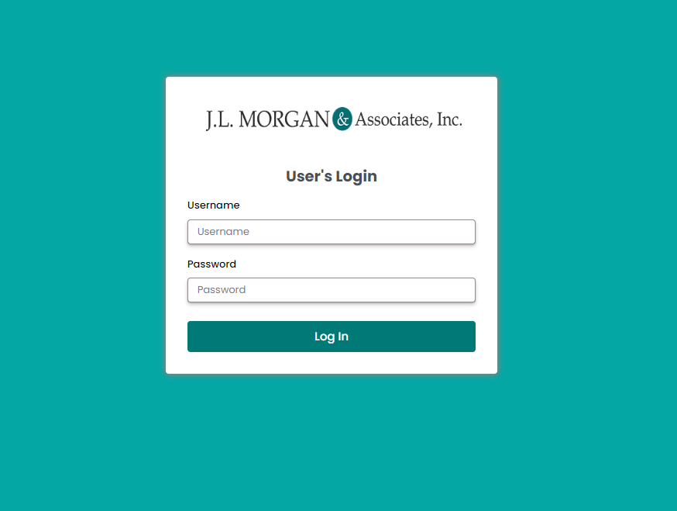
Login to client site
Login to https://jlm-solutions.com/
Enter Username and Password (contact JLM if you do not have a username assigned.

Slide 21
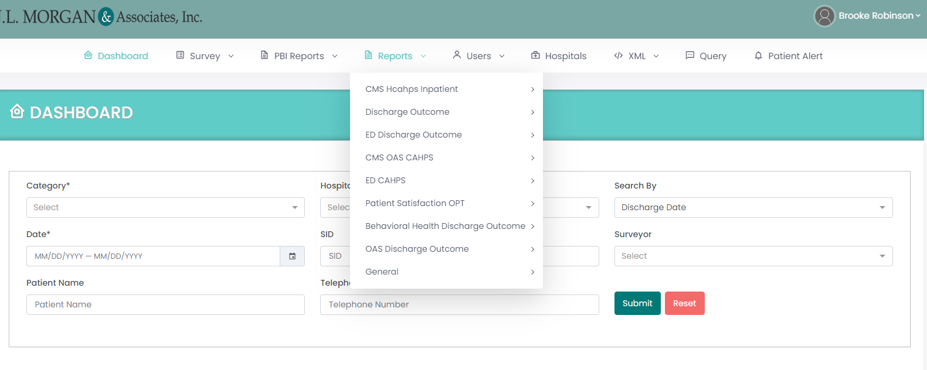
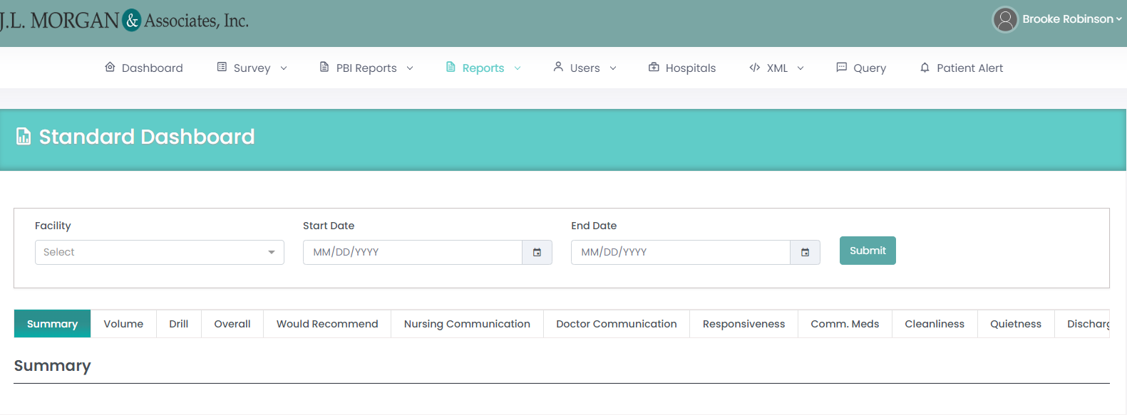
Running a Report
From this page, you can decide to select “Reports” or run a query from the database.
You have the option to run a report and export the data, depending on which JLM service you have.
If you click “CMS Hcahps Inpatient” you will be directed to the page and you will type in the “facility” and the date range you are looking for.
Client Login:
https://www.jlm-solutions.com/

Slide 22
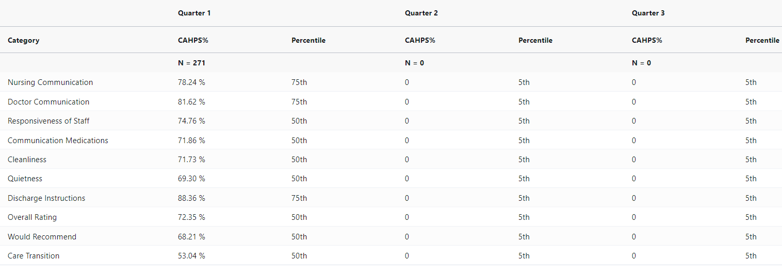
CMS HCAHPS National Percentile Comparison
Report Examples
Compares your hospital against the National Rankings (50th, 75th, 90th)
CMS Mode adjusted

Slide 23
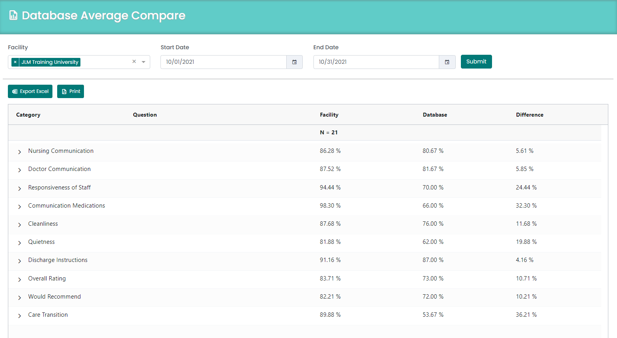
Report Examples
Database Average Comparison
Displays individual measures for each composite
Trend by: Decimal, Percent (Average) or Top Box format
Trend up to 12 months

Slide 24
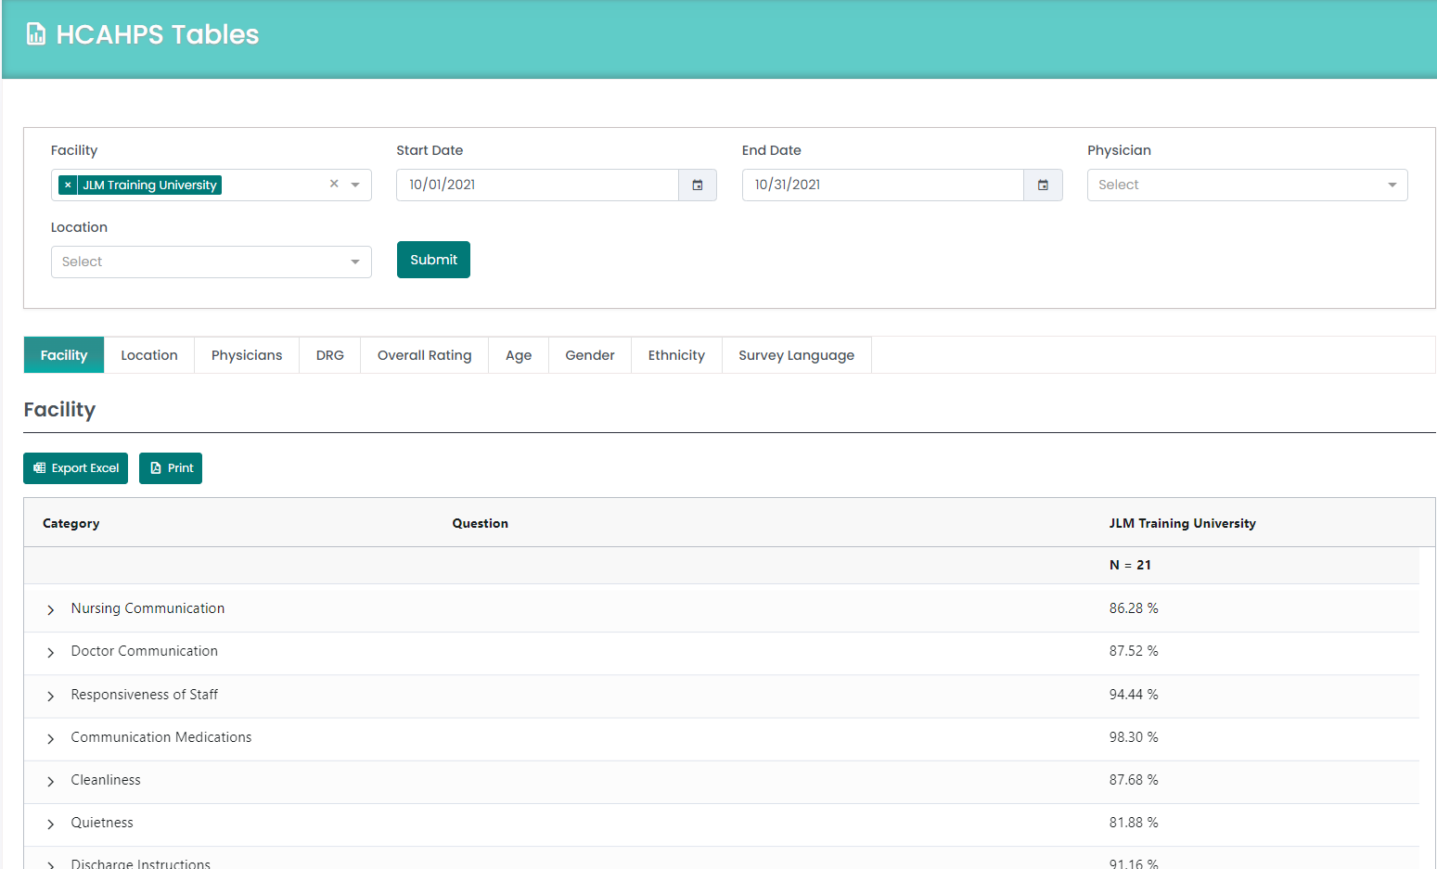
Report Examples
HCAHPS TABLES
Breaks down HCAHPS scores by unit, location, Physicians, DRG, Overall Rating, Age, Gender, Ethnicity, and Survey Language.
Identify largest areas for improvement by percentages.

Slide 25
Contact us for more Information!
Brooke Robinson
Marketing
Brooke.Robinson@jlm-solutions.com
Kristi BUrgess
Director of Business Development
Kristi.burgess@jlm-solutions.com
Wendy Dew
HCAHPS Director
Wendy.dew@jlm-solutions.com

